Slide 1
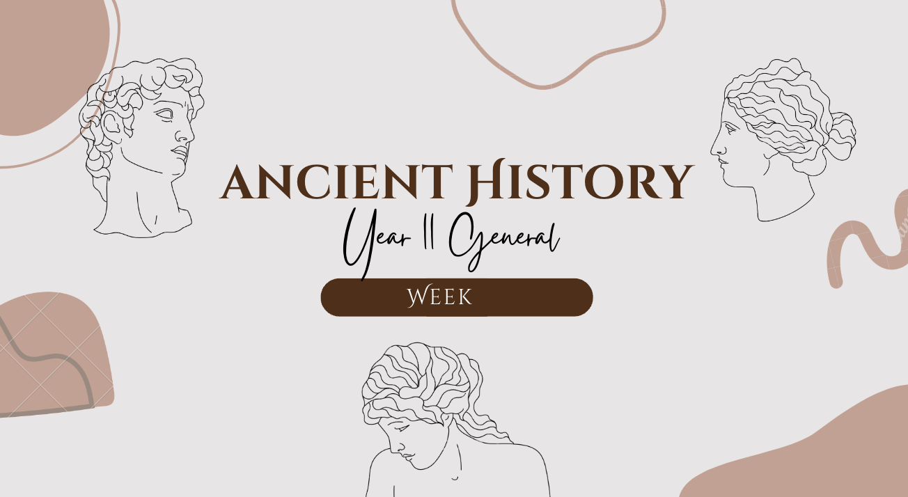
1
GOAL/S: Define chronological terminology
Lesson 1
Ms Barrie

Slide 2
Welcome to Ancient History
Ms Lauren Barrie
Lauren.barrie@education.wa.edu.au
Classroom:
Where to find me:

Slide 3
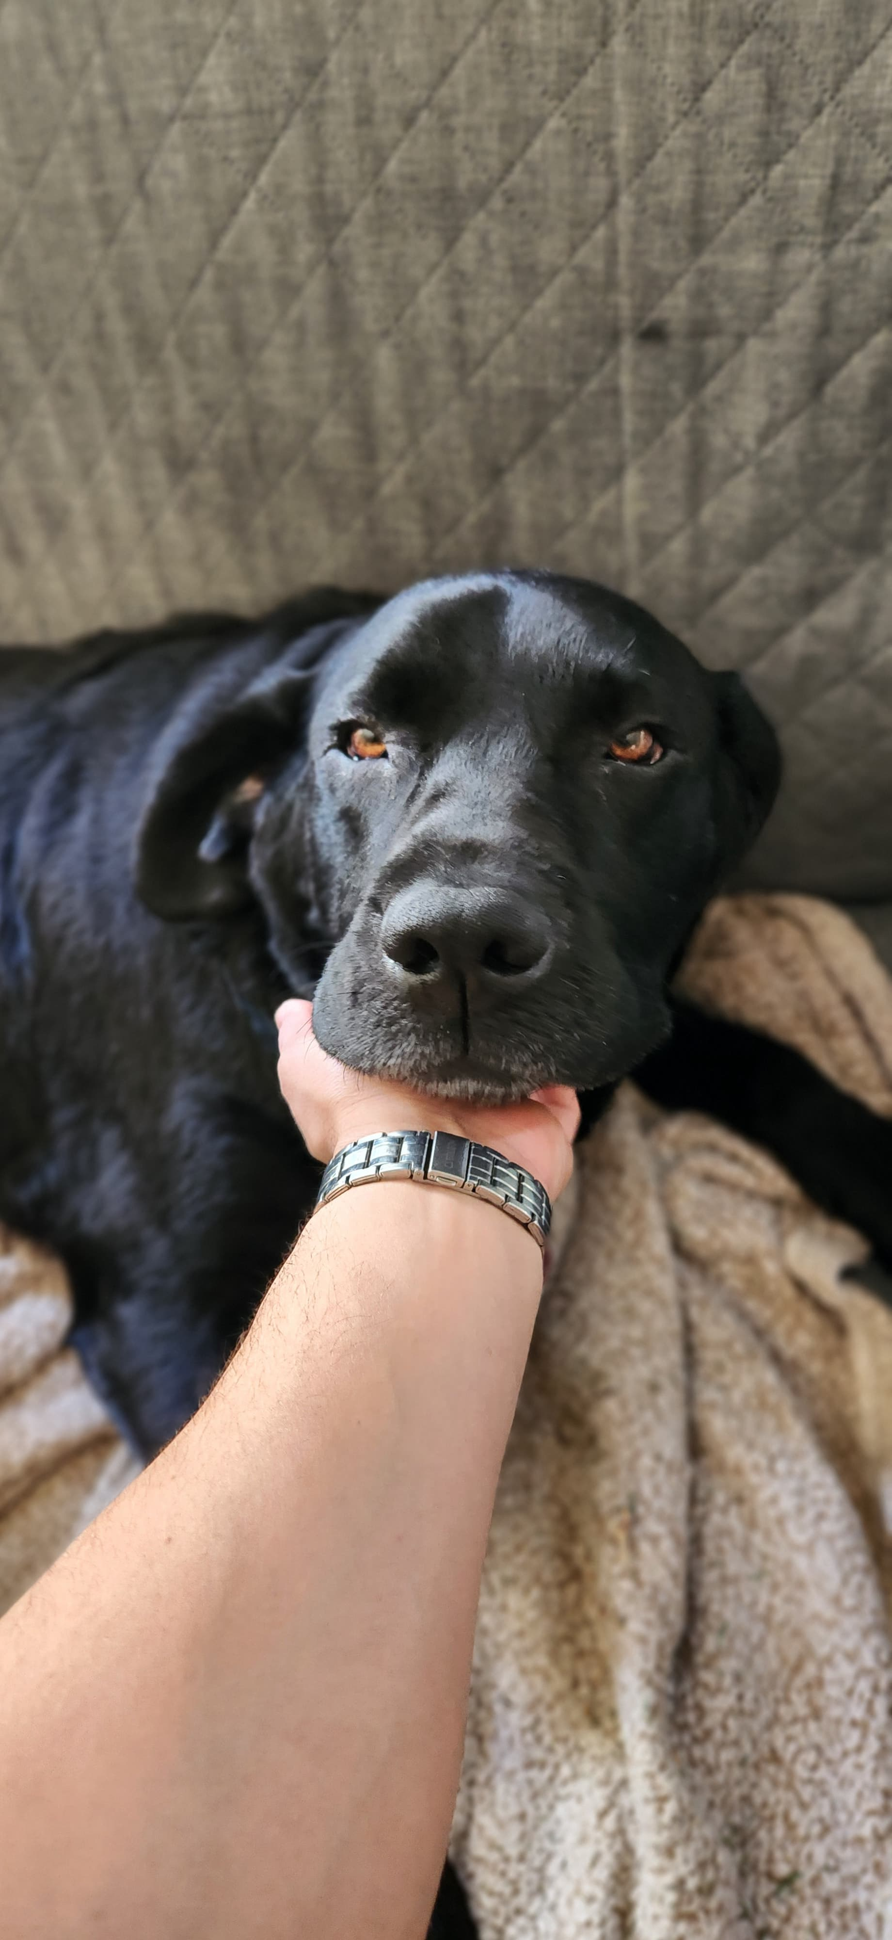
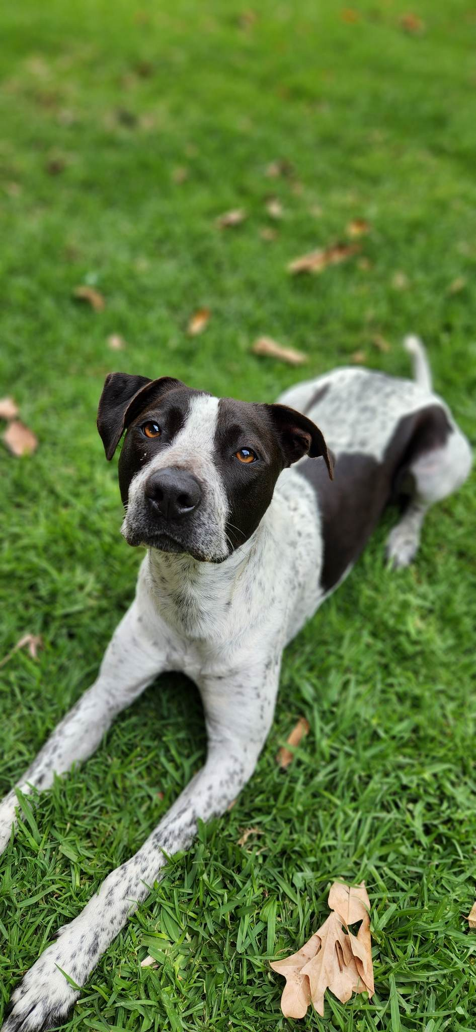



ABOUT ME

Slide 4



How to be successful
Values of my classroom
Notes:
Grit, Organisation, Integrity

Slide 5
Class Rules and Expectations
Show respect to me, each other, and the classroom
Be on time for class
Come prepared for class
Complete all tasks to the best of your ability
Catch up on missed work
Have a go at everything
Use Compass
If you do not follow these, your parents/guardians will be contacted.

Slide 6

What you will need
Workbook to write in
Pen for EVERY class (it is not expected that you rule up)
File for worksheets
Folder for assessments
Workbook, file, and folder will remain in the class

Slide 7
Course Overview
Year 11 General Ancient History
If you have any questions – please ask!

Slide 8
Unit 1 – Semester 1
We are learning about two Ancient Greek Civilisations!
1. Minoans
2. Mycenaeans

Slide 9
Week 1 | Overview of Ancient Greece - chronology, mapping geography
Week 2 - 4 | Features of Minoan Society - Social, political, economic, religious, military, cultural | Source Analysis Week 4
Week 5 - 7 | Mycenae Overview Trojan War/Troy/Homer’s Iliad | Explanation (Essay) Week 7
Week 8 - 9 | Representations in Mycenae Archaeology/Evidence Downfall
Week 10 | OVERVIEW/REVISION Compare and contrast Minoans and Mycenaeans | Test
Week 11 - 15 | Investigation of an Ancient Civilisation or culture Questioning and research Explanation and Communication | Inquiry Project

Slide 10

Other things
Your workbook
Revision/help
Permission Slips
This sign ->

Slide 11

Any questions?

Slide 12
History is like a story…
Events
Ideas
People
Sources
Perspectives
Cause
Effect
Continuity
Change
History

Slide 13
Today’s Lesson
Chronology
Time Periods
Timelines

Slide 14

What do you already know about ‘Chronology’?
Discussion question

Slide 15
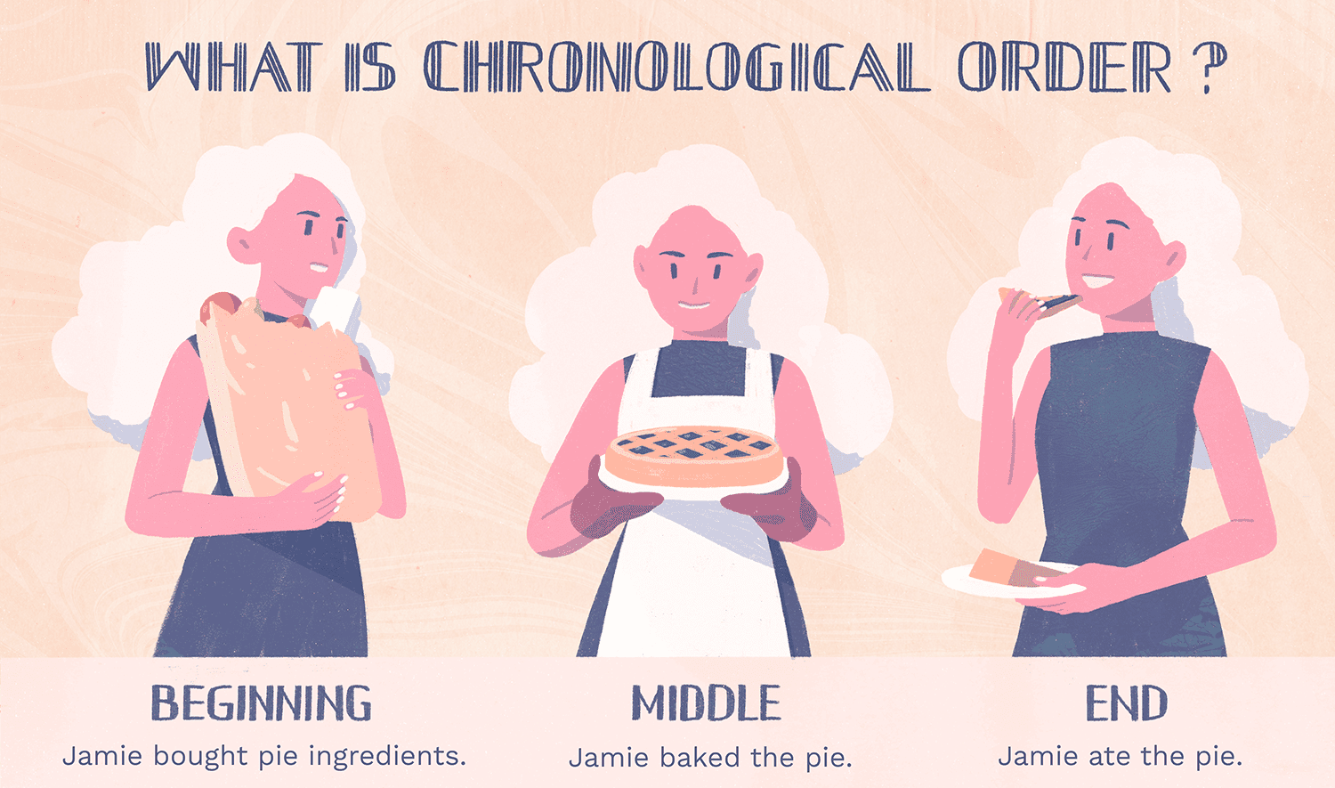
Chronology
KEY TERM
Definition: the study of when things happened
’Chrono’ meaning TIME
‘Logy’ meaning STUDY OF/ACCOUNT OF
Historians put events in CHRONOLOGICAL ORDER of when they happened to put a story together

Slide 16
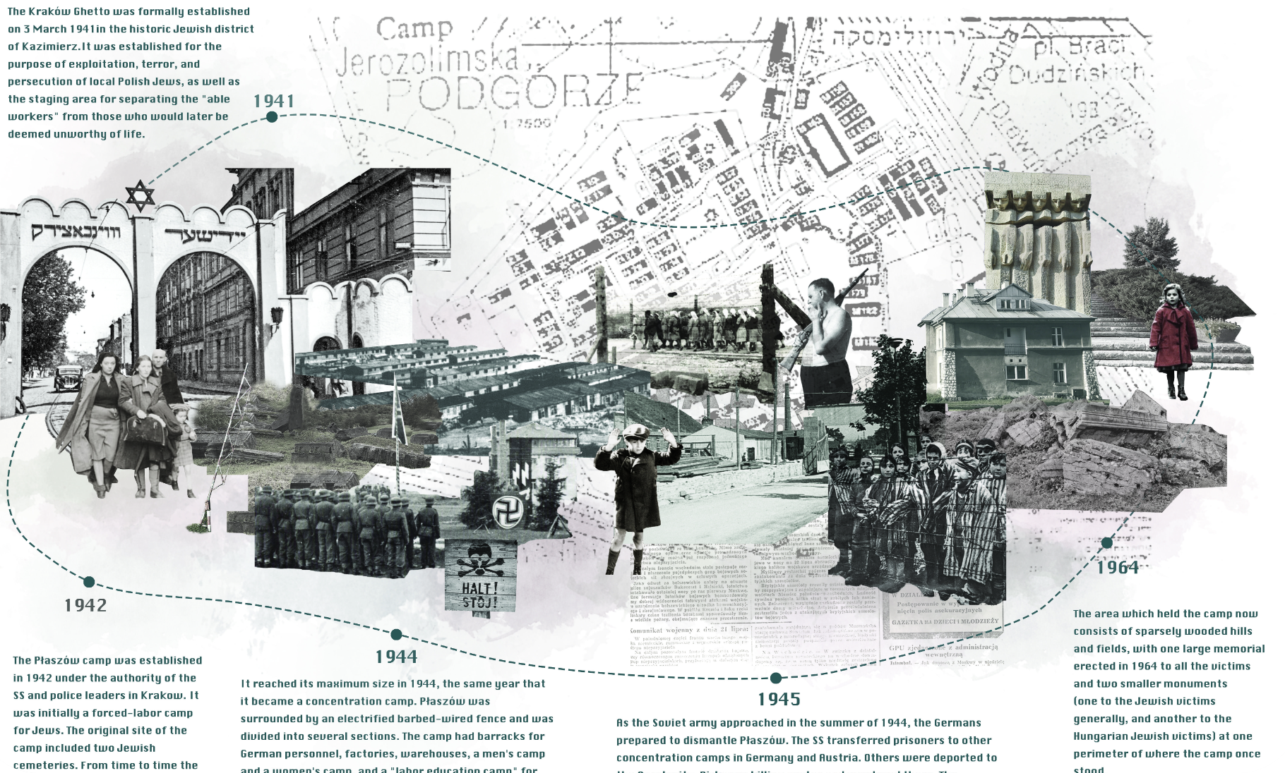
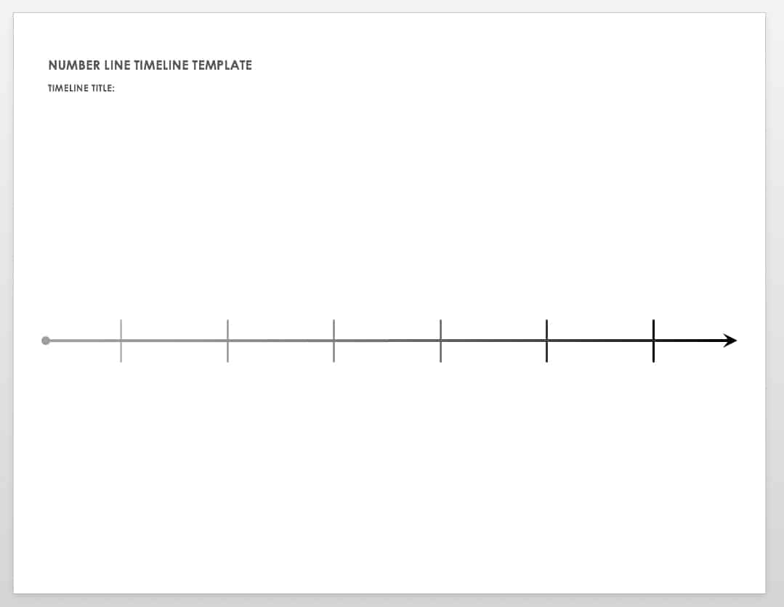
What it is
What it is NOT
Notes:
CHECK FOR UNDERSTANDING HERE – Repeat Definition

Slide 17
BCE
KEY TERM
Definition:
Before the Common Era
✨ BCE✨
😀
2000
1000
1000
2000
0
The Great Pyramid of Giza (Egypt) was built in 26BCE

Slide 18
CE
KEY TERM
Definition:
Common Era
✨ CE✨
😀
2000
1000
1000
2000
0
The Sydney Opera House was built in 1973CE

Slide 19
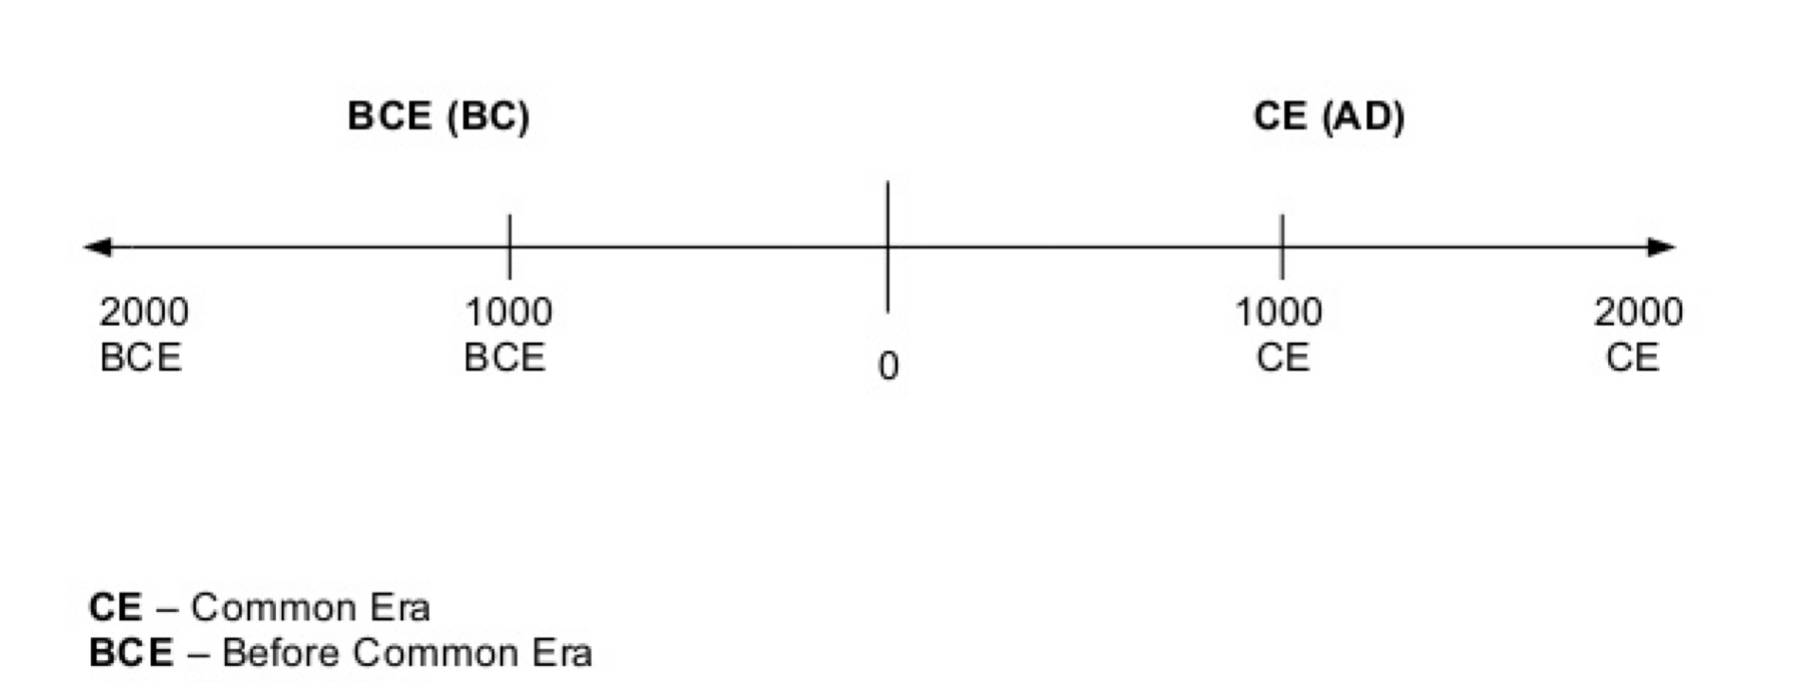
Draw the following
Notes:
**Late Bronze Age Greece and Troy c. 1500 - 1050 BCE**

Slide 20
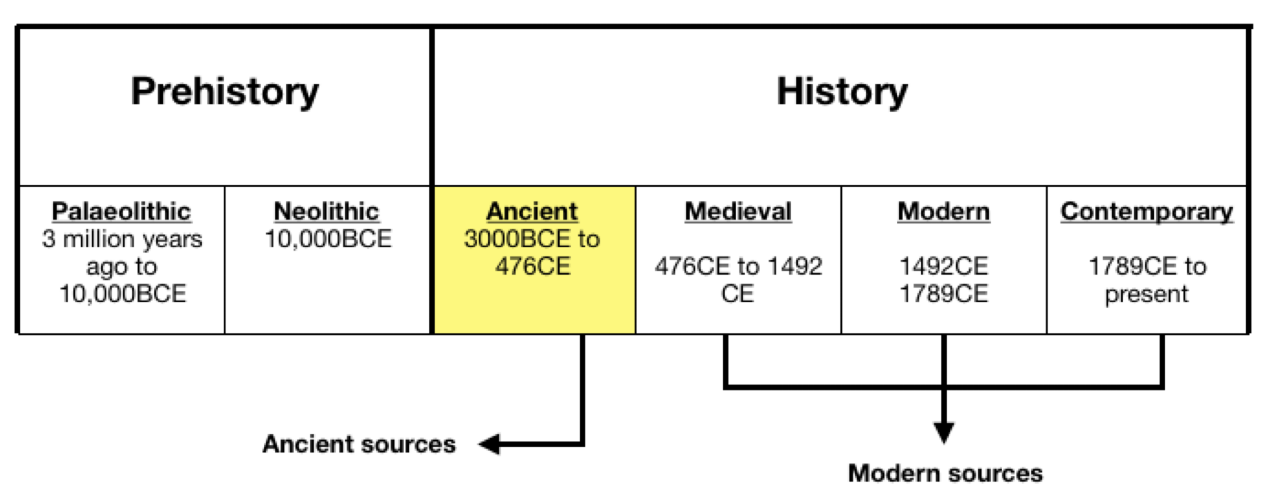
Where does ‘ANCIENT’ history fit?
Beginning of writing and recorded human history to fall of Western Roman Empire

Slide 21
QUIZ – Mini Whiteboards
Grab ONE (1) Mini Whiteboard between TWO (2)
STEP 1 - HOVER IT
STEP 2 - CHIN IT
STEP 3 - PARK IT

Slide 22
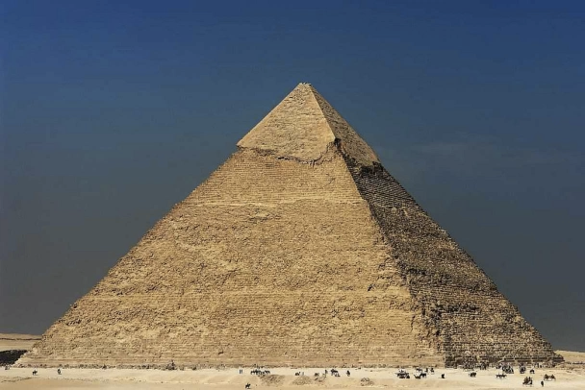
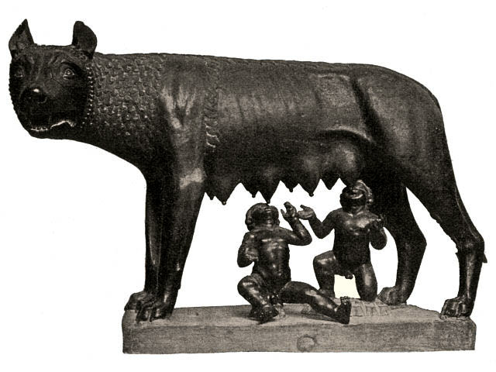
1. Which is earlier in history?
A
The Ancient Egyptians Build the Great Pyramid of Giza for Pharaoh Khufu in Egypt
c. 2560 BCE
B
The foundation of Rome
c. 753 BCE
OR

Slide 23
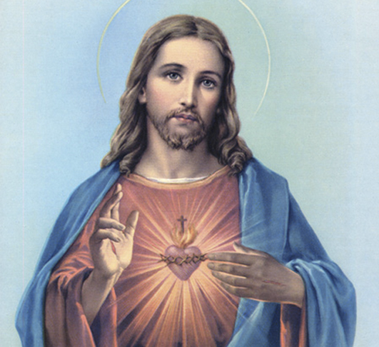
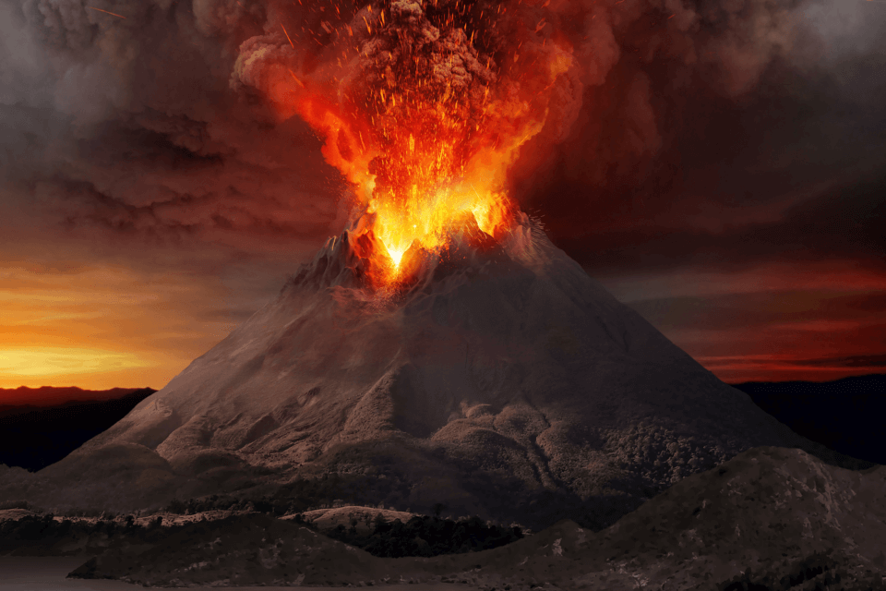
2. Which is earlier in history?
A
Birth of Jesus Christ
c.4 BCE (Egypt)
B
Mount Vesuvius erupts burying the Roman cities of Pompeii and Herculaneum
C.79CE
OR

Slide 24
3. What TIME PERIOD are WE studying?
1800BCE – 1500 BCE
1500BCE - 1050 BCE
1550BCE - 1000 BCE
1480BCE - 1000 BCE
Notes:
B

Slide 25
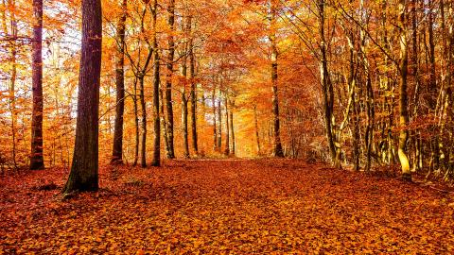

4. What event often marks the END of the Ancient Era?
Notes:
B

Slide 26

5. What is ONE thing you can do to PASS this course?
Notes:
B

Slide 27
EXTRA TIME ACTIVITY About Me Slip
Complete the ‘About Me’ Slip Independently and give it to Ms Barrie ☺

